Slide 1


What Makes a Code Change Easier To Review: An Empirical Investigation on Code Change Reviewability
Achyudh Ram, Anand Ashok Sawant,
Marco Castelluccio and Alberto Bacchelli

Slide 2
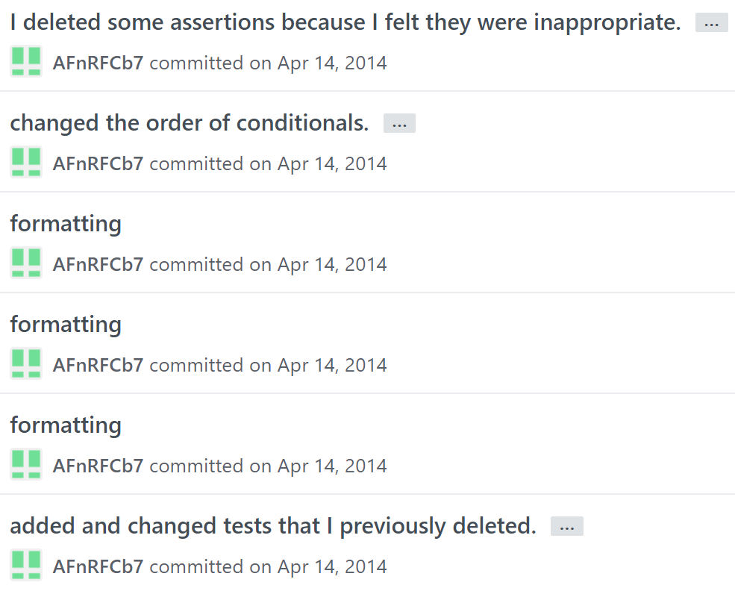

Slide 4
“Rework your commit history in order to see what your changes actually involves and split multiple fixes in separate PRs”

Slide 5

Reviewability $≠$ Acceptability
Notes:
Same as paper reviewing

Slide 6
What Makes a Code Change Easier To Review: An Empirical Investigation on Code Change Reviewability
Achyudh Ram, Anand Ashok Sawant,
Marco Castelluccio and Alberto Bacchelli

Slide 7
Research questions
RQ1: What makes a good code change, according to white and gray literature?
RQ2: What do reviewers associate with code change reviewability?

Slide 8


Our study
Multivocal literature review
Study with developers

Slide 9
Our study
Multivocal literature review
Study with developers

Slide 10



Phase 1: MLR - Methodology
Sources:
Google scholar
IEEE Explore
ACM Digital library
12 initial paper selection
Keywords:
Code review
Code review practices
Pull request acceptance
Evaluating contributions on GitHub
Pull based development
Sources:
ICSE
FSE
ICSME
TSE
TOSEM
28 further papers selected
Filter based on relevance
22 papers selected

Slide 11

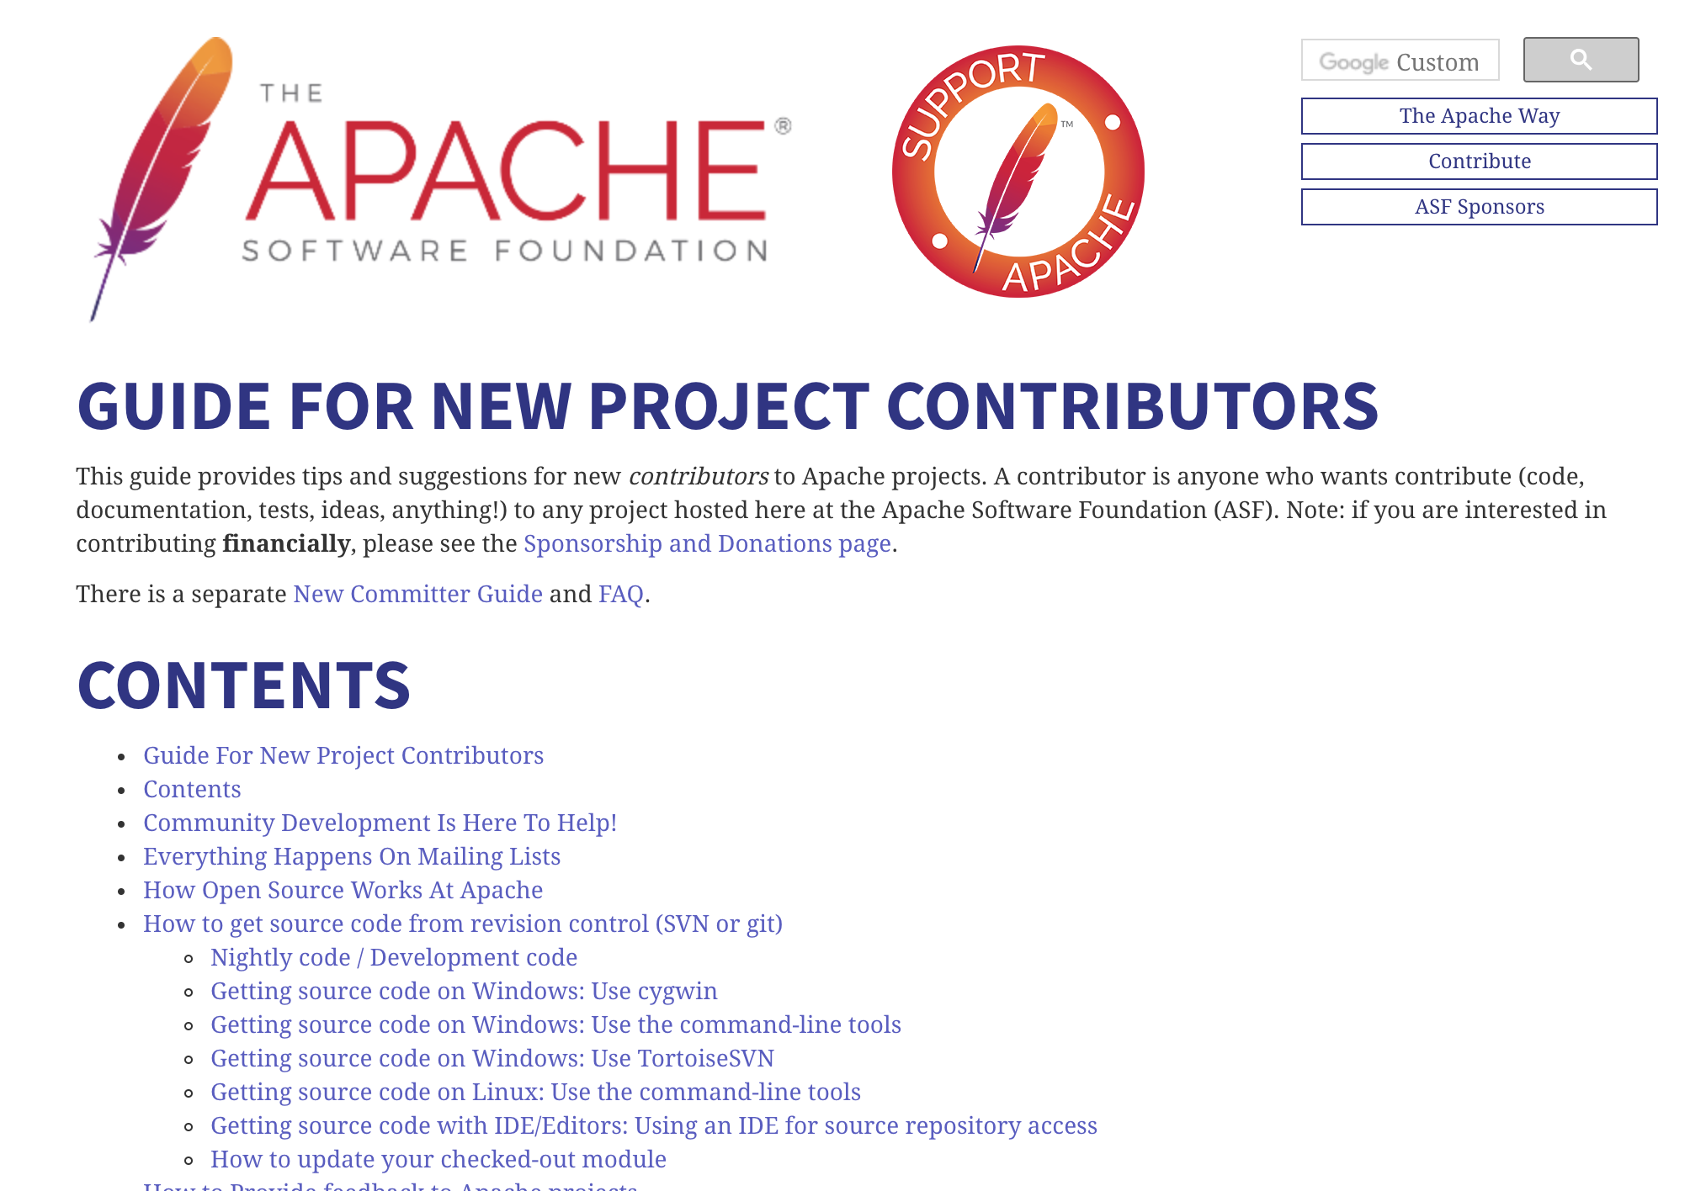
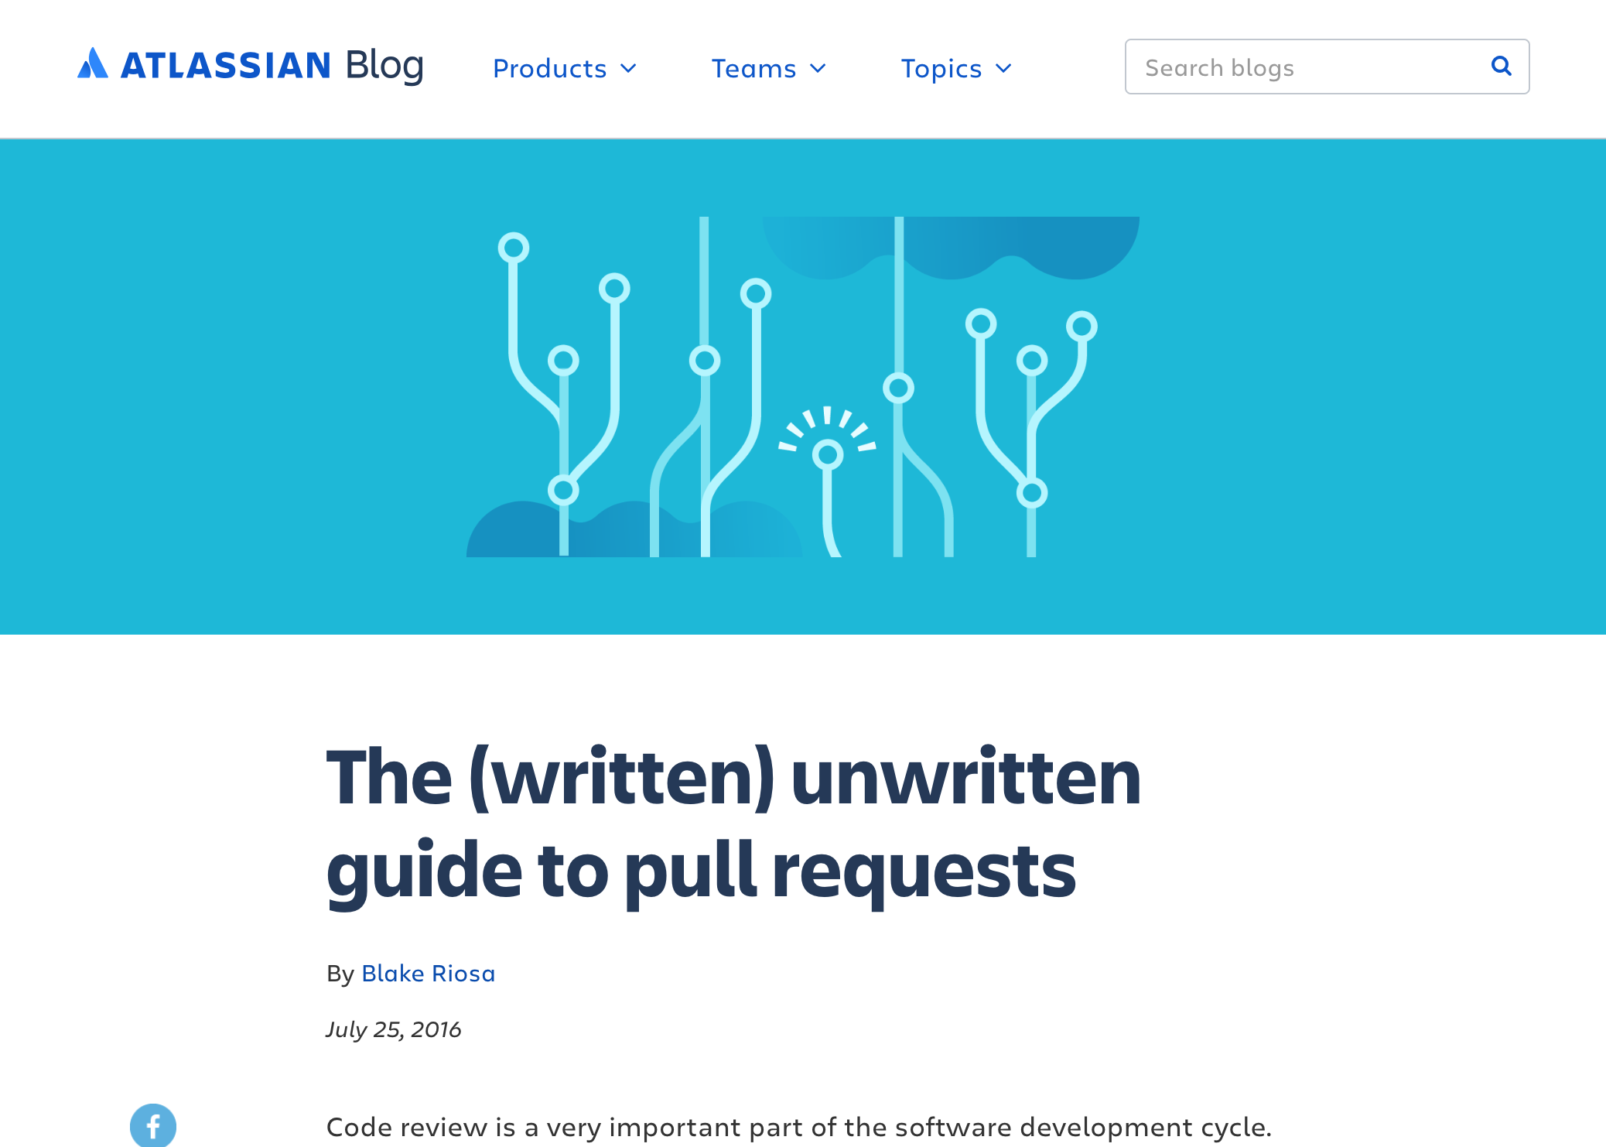

Phase 1: MLR - Methodology
55 initial sources selected
Keywords:
Code submission guidelines
Code review practices
Pull request guidelines
GitHub contributing.md
Pull request review preparation
21 sources selected

Slide 12
Phase 1: MLR - Themes identified
Change description
Commit history
Change scope
Composite changes
Code churn
Nature of the change
Code quality
Subsystem hotness
Code style
Test inclusion

Slide 13
Our study
Multivocal literature review
Study with developers

Slide 14
Phase 2: Developer study
Change description
Commit history
Change scope
Composite changes
Code churn
Nature of the change
Code quality
Subsystem hotness
Code style
Test inclusion

Slide 15
Phase 2: Developer study
Task-based interviews
Tool-based feedback

Slide 16
Phase 2: Developer study
Task-based interviews
Tool-based feedback

Slide 17
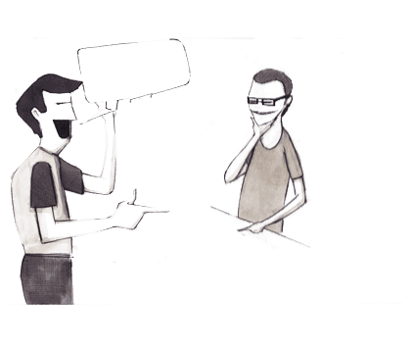
Task-based interviews
Industry: HP, Google, Microsoft, Milvum, SET
OSS: Spring
Interview 10 developers

Slide 18
Task-based interviews - Methodology
Interview 10 developers
Each interview consisted of 3 changesets
5 interviews with one set of changes and then other 5 interviews with another set

Slide 19
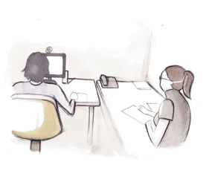


Task-based interviews
Interview 10 developers
Analyze transcripts
Ranking of factors
Emergent themes

Slide 20
Task-based interviews - Results
Change description
Commit history
Change scope
Composite changes
Code churn
Nature of the change
Code quality
Subsystem hotness
Code style
Test inclusion

Slide 21
Task-based interviews - Results
Change description
Commit history
Change scope
Composite changes
Code churn
Nature of the change
Code quality
Subsystem hotness
Code style
Test inclusion
Notes:
See that there is minimal overlap between what contributes to reviewBILITY AS OPPOSED TO acceptability don’t use red, make it more transparent

Slide 22
Task-based interviews - Results
I
Change description
II
Code churn
III
Commit history
Notes:
Put number on the left change to roman numerals

Slide 23
Task-based interviews - Results
I
The patch description is important for reviewing, as one has to understand why and not only what changes have been made
– P4 (SET GmBh)
Change description
II
Code churn
Code does not lie, people do lie
– P9 (Spring)
III
Commit history
Notes:
Replace P’s with companies

Slide 24
Task-based interviews - Results
I
Smaller changes are easier to review
– P10 (Spring)
Change description
Changes are bucketed based on size before review
– P7 and P8 (Google)
II
Code churn
Amount of functionality is more important than the amount of code
– P9 (Spring)
III
Commit history

Slide 25
Task-based interviews - Results
I
Small and focused commits aid reviewability
– P7 (Google)
Change description
Commits that say ‘fix this’, ‘fix that’ are unintelligible and developers should rebase them to fix the history
– P7 and P8 (Google)
II
Code churn
III
Commit history

Slide 26
Task-based interviews - Results
What impact does reviewability issues have on acceptance?
It is more of a soft or temporary rejection as opposed to a hard reject
– P1 (Microsoft)
If the reviewability issues are not solved immediately, the patch is rejected and the change is made by the internal developer himself
– P9 (Spring)

Slide 27
Phase 2: Developer study
Task-based interviews
Tool-based feedback

Slide 28
Phase 2: Developer study
Task-based interviews
Tool-based feedback

Slide 29
Tool-based feedback - Propr
Propr
http://propr.tudelft.nl/

Slide 30
Tool-based feedback - Propr
Installed as a Firefox plugin or GitHub integration
Works with Mozreview, Bugzilla, Reviewboard and GitHub
Propr
http://propr.tudelft.nl/

Slide 31
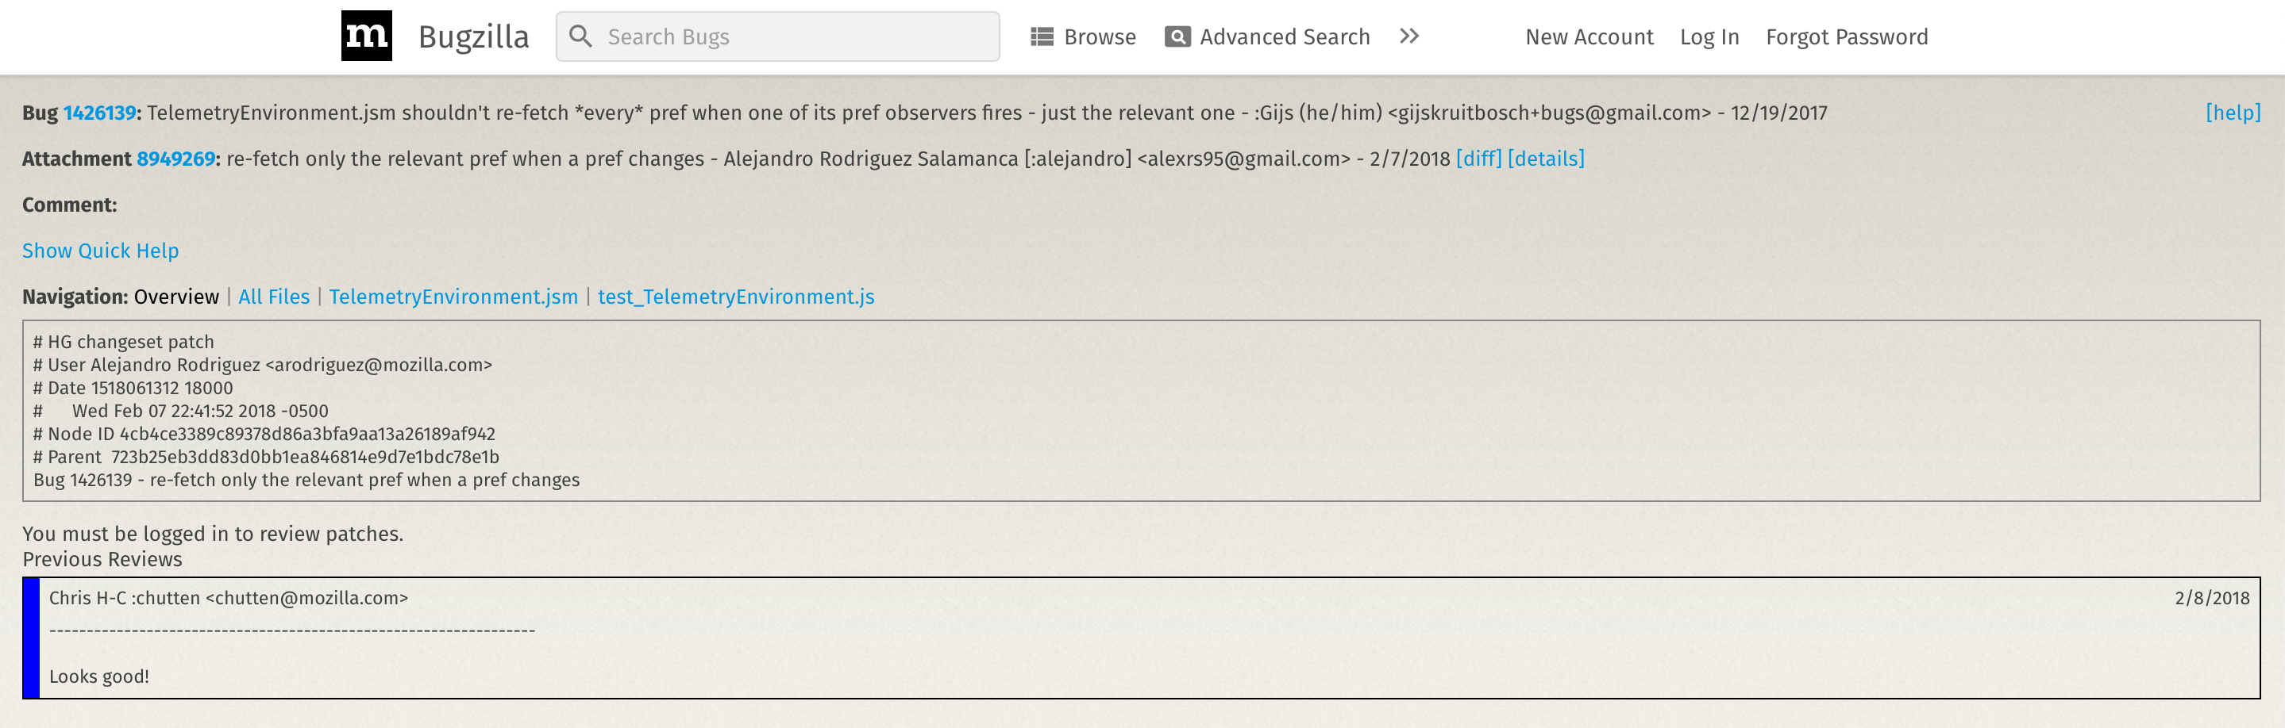

Tool-based feedback - Propr

Slide 32
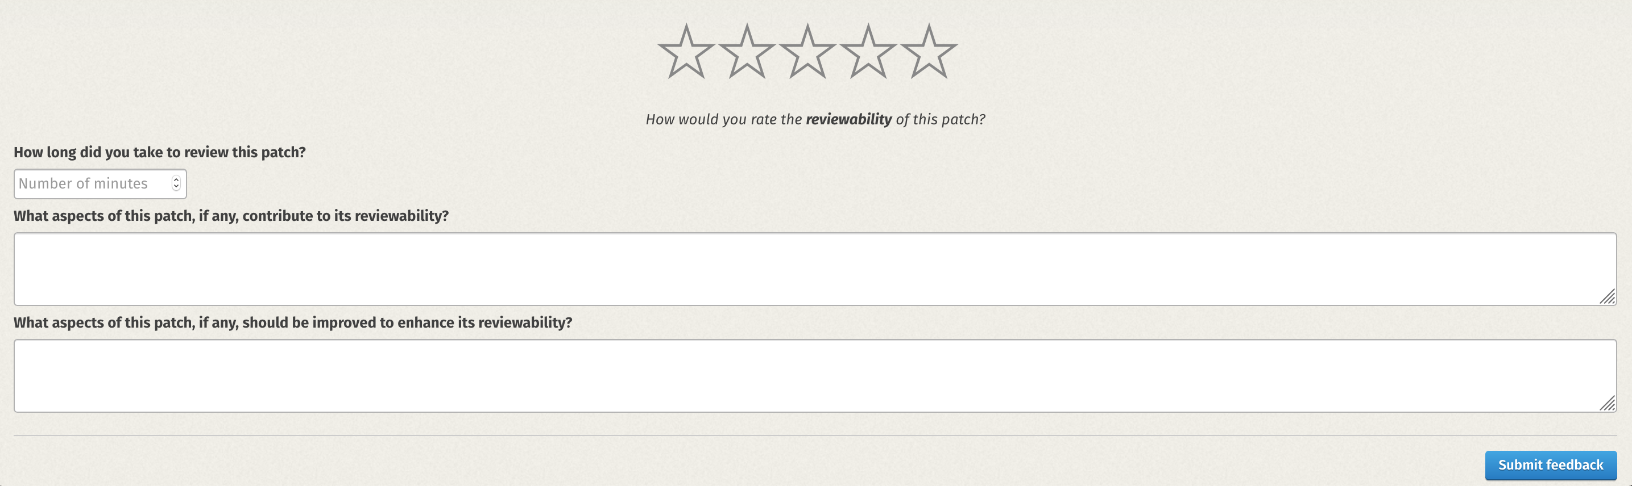
Tool-based feedback - Propr

Slide 33
Tool-based feedback - Propr

Slide 34
Phase 2: Tool-based feedback - Propr
Feedback dashboard
Notes:
Used as an incentive

Slide 35
Tool-based feedback - Propr
Dataset overview:
Feedback on 98 changes
35 reviewers
6 projects from Mozilla
3 OSS projects
Propr
http://propr.tudelft.nl/

Slide 36
Tool-based feedback - Analysis
Developer feedback
Review comments
Source code

Slide 37

Tool-based feedback - Results
Positively evaluated
Negatively evaluated
Change description
Code churn
Commit history
Change scope
Code style
Reviewers are mostly negative in review comments but are more ready to provide positive feedback using our tool
Notes:
Merge in 1

Slide 38
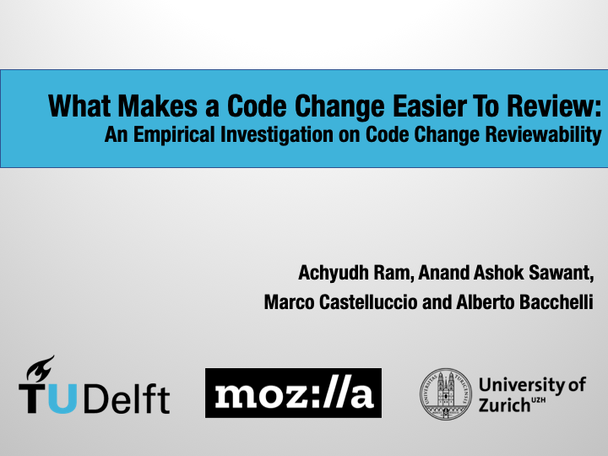
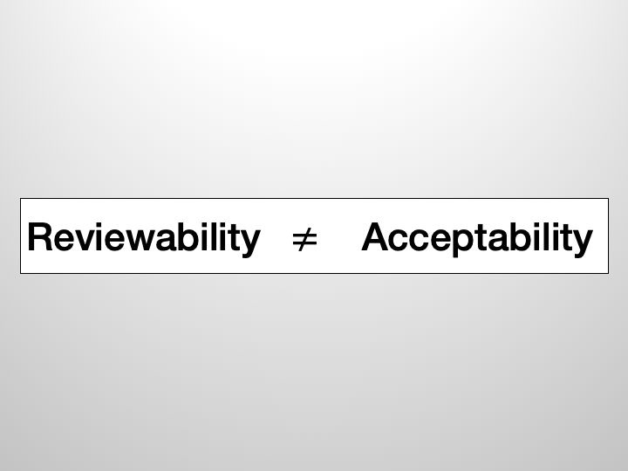

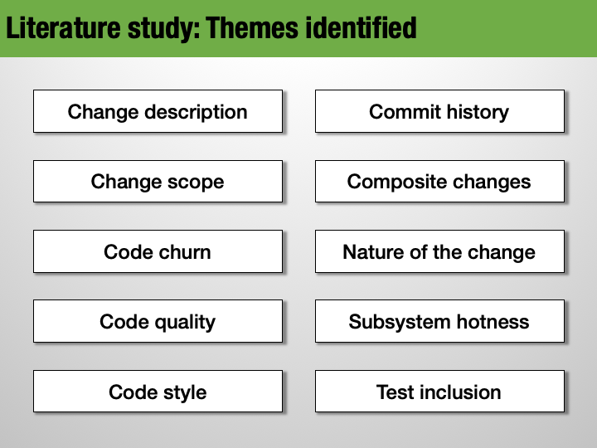

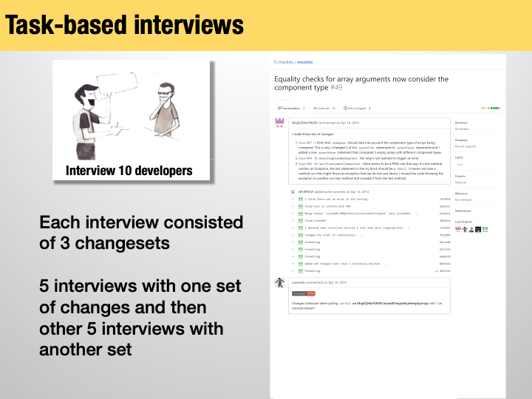
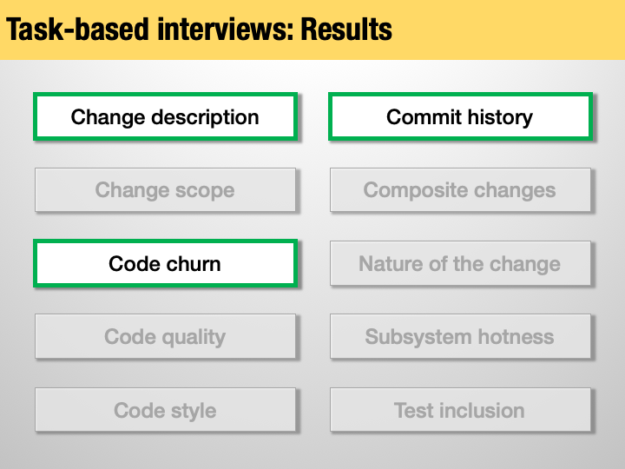
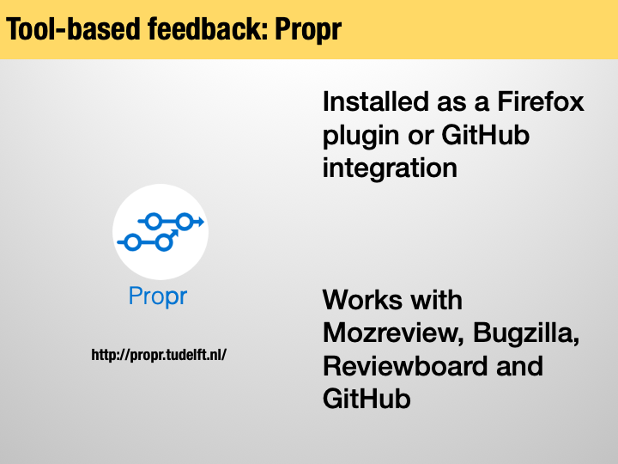
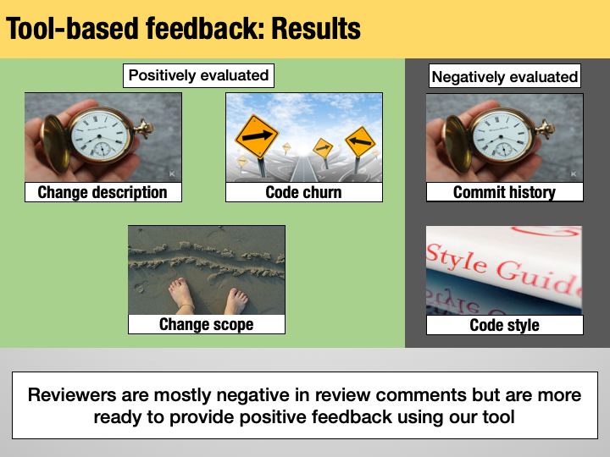
Notes:
Add summary slides here

Slide 39
Code change reviewability can be empirically defined as how well a change is (1) explained (‘change description’ and ‘commit history’), (2) properly sized and self-contained (‘code churn’ and ‘change scope’), and (3) aligned with the project’s style (‘code style’)
Notes:
Add summary slides here

